Slide 1

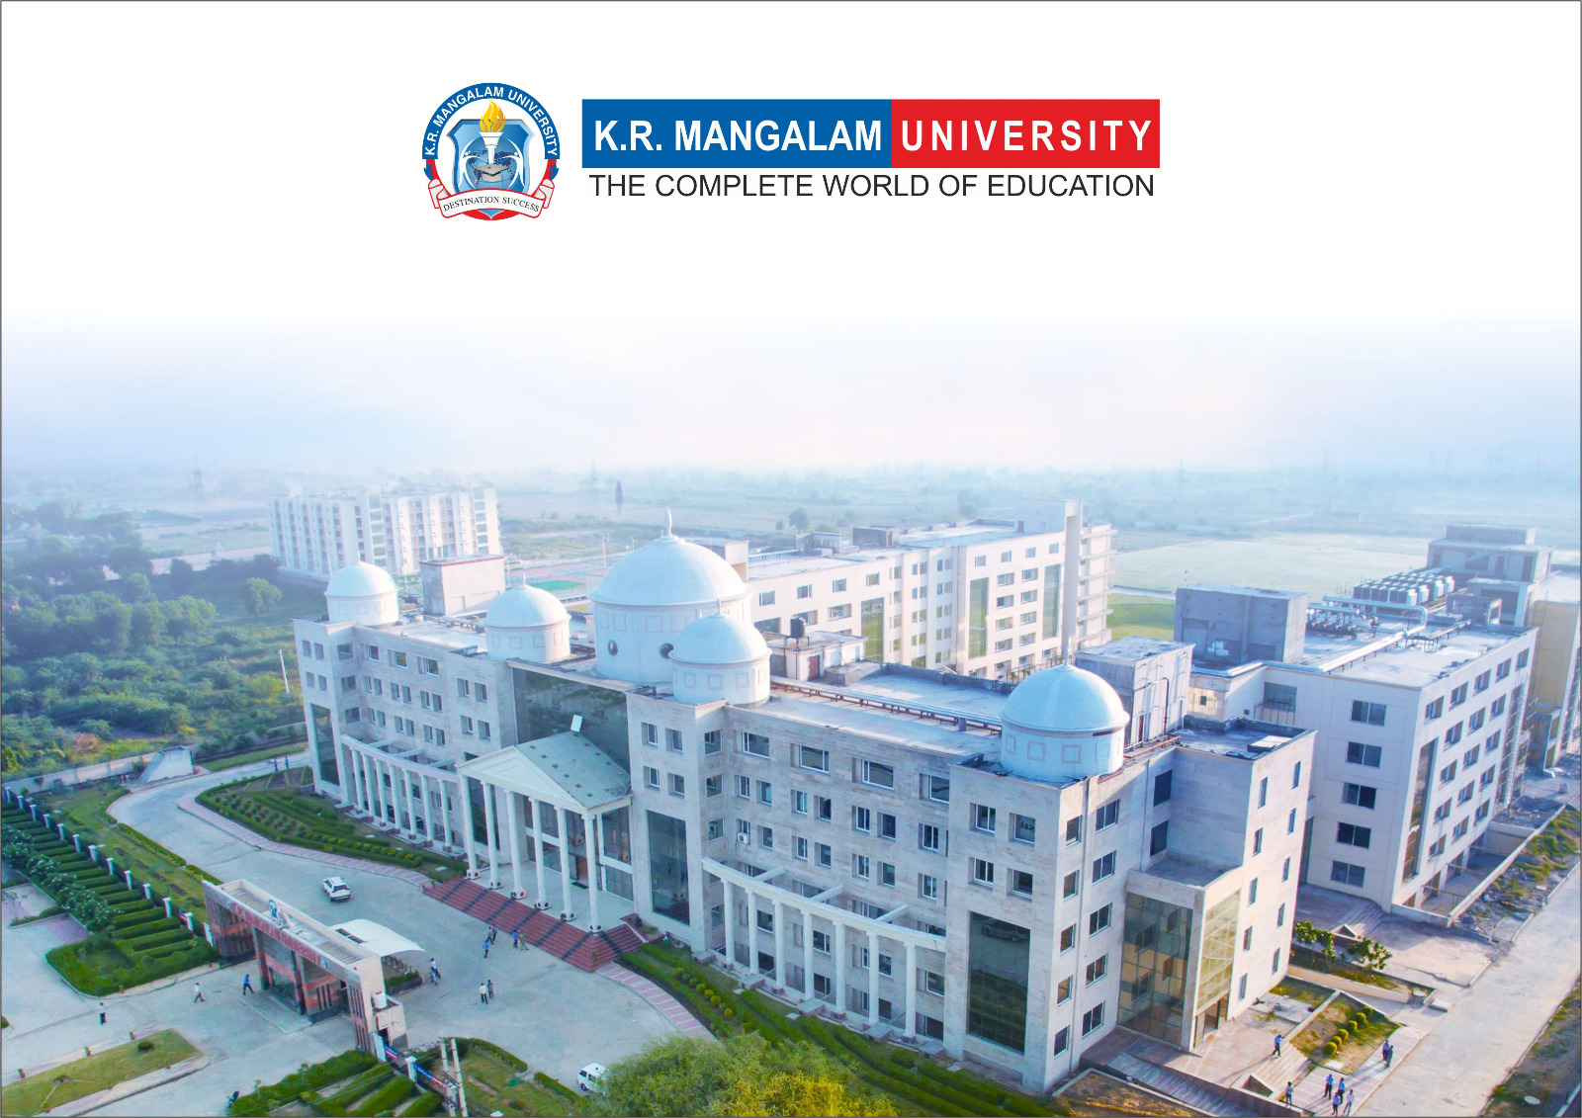
Introduction to Water Chemistry & Hardness
Course Code: ETMLCH104
Course Name: Engineering Chemistry
Program: B.Tech. (AI/ML)
Unit1:Water technology & Chemical Fuels
Dr Pratibha Sharma
Assistant Professor, Department of Chemistry
School of Basic and Applied Sciences
K.R. Mangalam University
Sohna Road, Gurugram

Slide 2

Course Overview
Unit Number: 1 | Title: Water technology | No. of hours: 6
Introduction, water analysis: Hardness-determination by EDTA method, Treatment of boiler feed water: Internal treatment (Phosphate, Colloidal and Calgon conditioning). External treatments: Ion exchange and lime-soda process, Zeolite processes. Boiler scales formation and ill effects, methods of prevention of scales. Numerical problems
Unit Number: 2 | Title: Chemical Fuels | No. of hours: 9
Fuels: Introduction, classification, calorific value (HCV & LCV), Determination of calorific value of fuel using Bomb calorimeter. Solid fuel: Coal- its analysis by proximate and ultimate analysis, Numerical problems. Liquid fuels: Refining of petroleum, Petroleum cracking, Knocking in IC engine, its ill effects and prevention of knocking. Anti-knocking agent: Leaded and unleaded petrol. Gaseous fuels: LPG, CNG and their applications.
Unit Number: 3 | Title: Battery Technology | No. of hours: 10
Introduction - Galvanic cell, electrode potential, EMF of the cell and cell representation. Batteries and their importance, Classification of batteries- primary, secondary and reserve batteries with examples. Battery characteristics - voltage, capacity, energy density, power density, energy efficiency, cycle life and shelf life. Construction, working and applications of: Ni-Cd, and Lithium-ion battery. Working principle of an electric vehicle.
Unit Number: 4 | Title: Polymer | No. of hours: 5
Basic concepts of polymer, Types of polymers, Thermoplastic & thermosetting plastics, Preparation and application of some industrially important polymers (Natural rubber, Buna S, Buna-N, Neoprene, Isoprene, Nylon-6, nylon-6,6 , Decron and Terylene). Conducting and biodegradable polymers.

Slide 3
COURSE OUTCOMES
CO1: Understand the methods for water hardness and the basics of boiler water treatment and analyze fuel calorific values and battery.
CO2: Explain the characteristics and working principles of different battery types and types of fuels.
CO3: Determine the differences between batteries and fuel cells and classify fuel cell types based on their components..
CO4: Identify between hard and soft water, solve the related numerical problems on water purification and emf and its significance in industry and daily life.

Slide 4
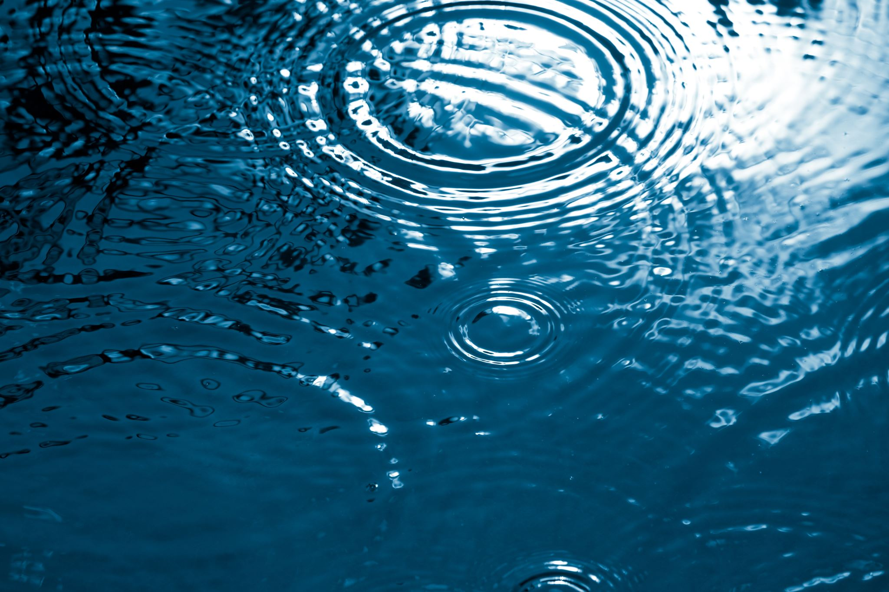
Introduction to Water Chemistry & Hardness

Slide 5
Contents
Introduction
Sources of Water
Characteristics of Water
Hardness of water
Types of Hardness
The Imperative of Measuring Water Hardness
Degree of Hardness
Assignment
Quiz
Take away of session
References

Slide 6
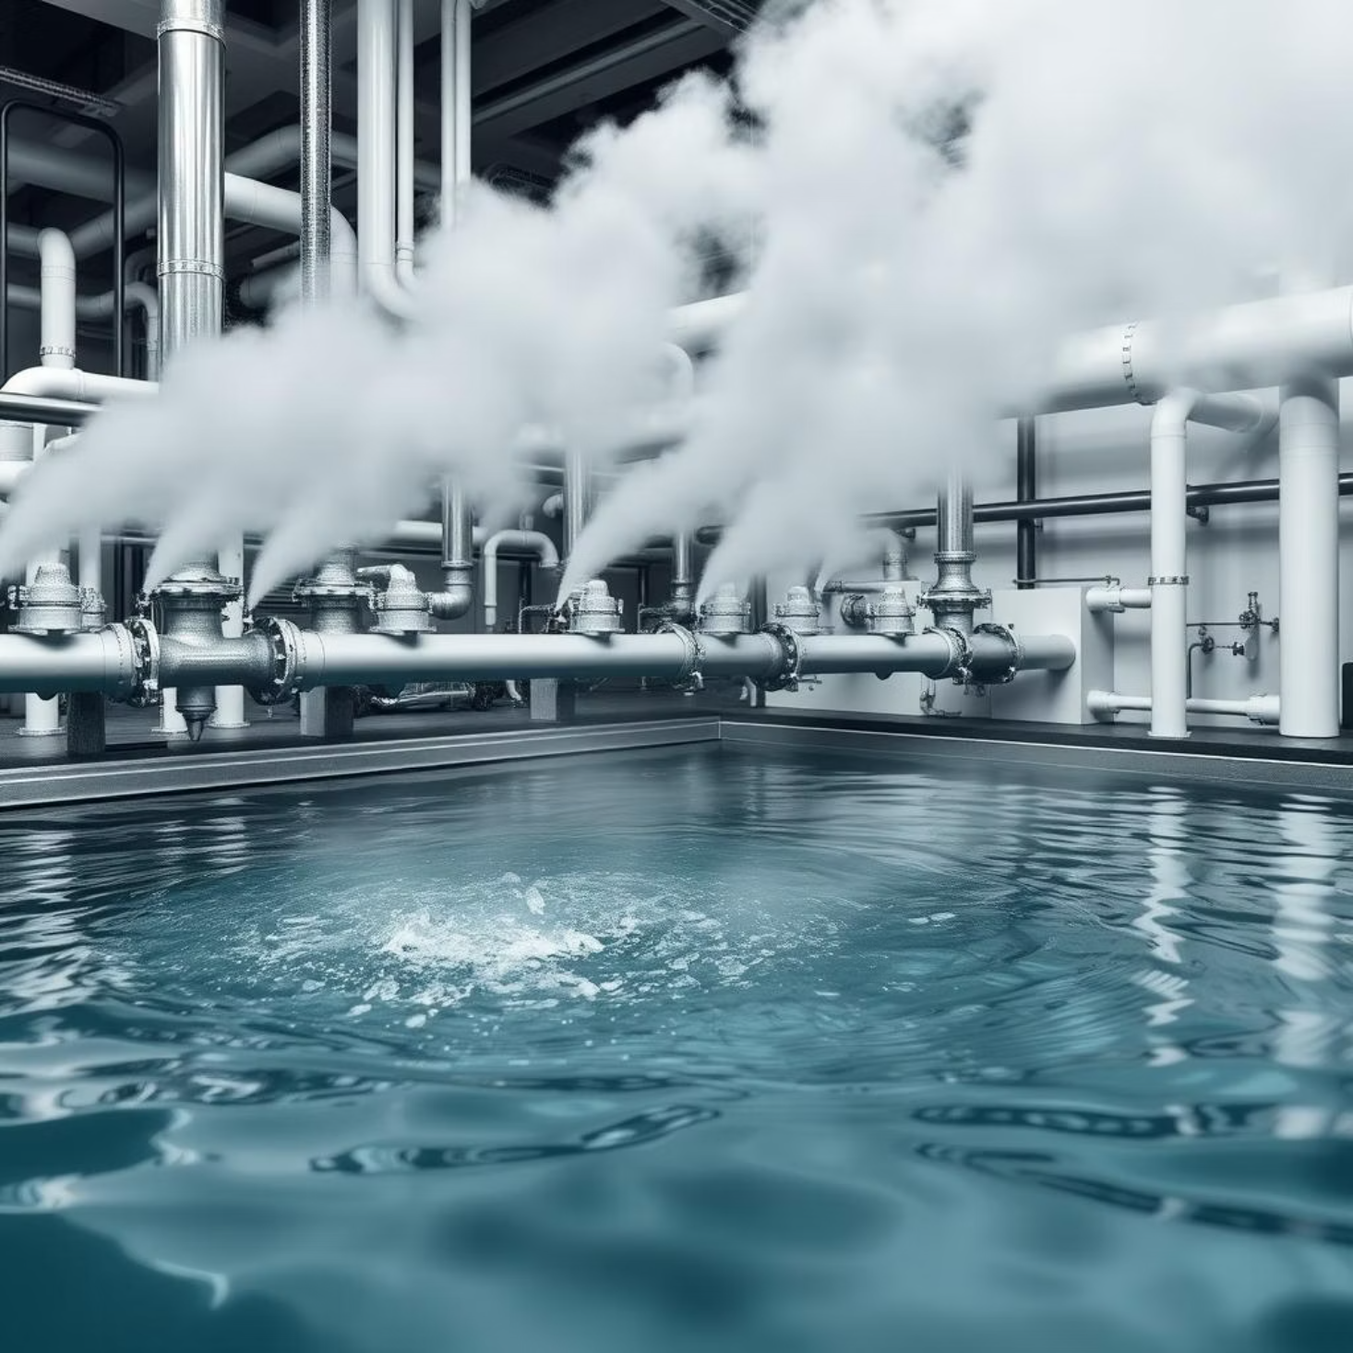
Introduction of Water in Industry
Used as coolant, solvent, reagent, and cleaner
Essential for steam generation and processing
Quality of water affects equipment life

Slide 7
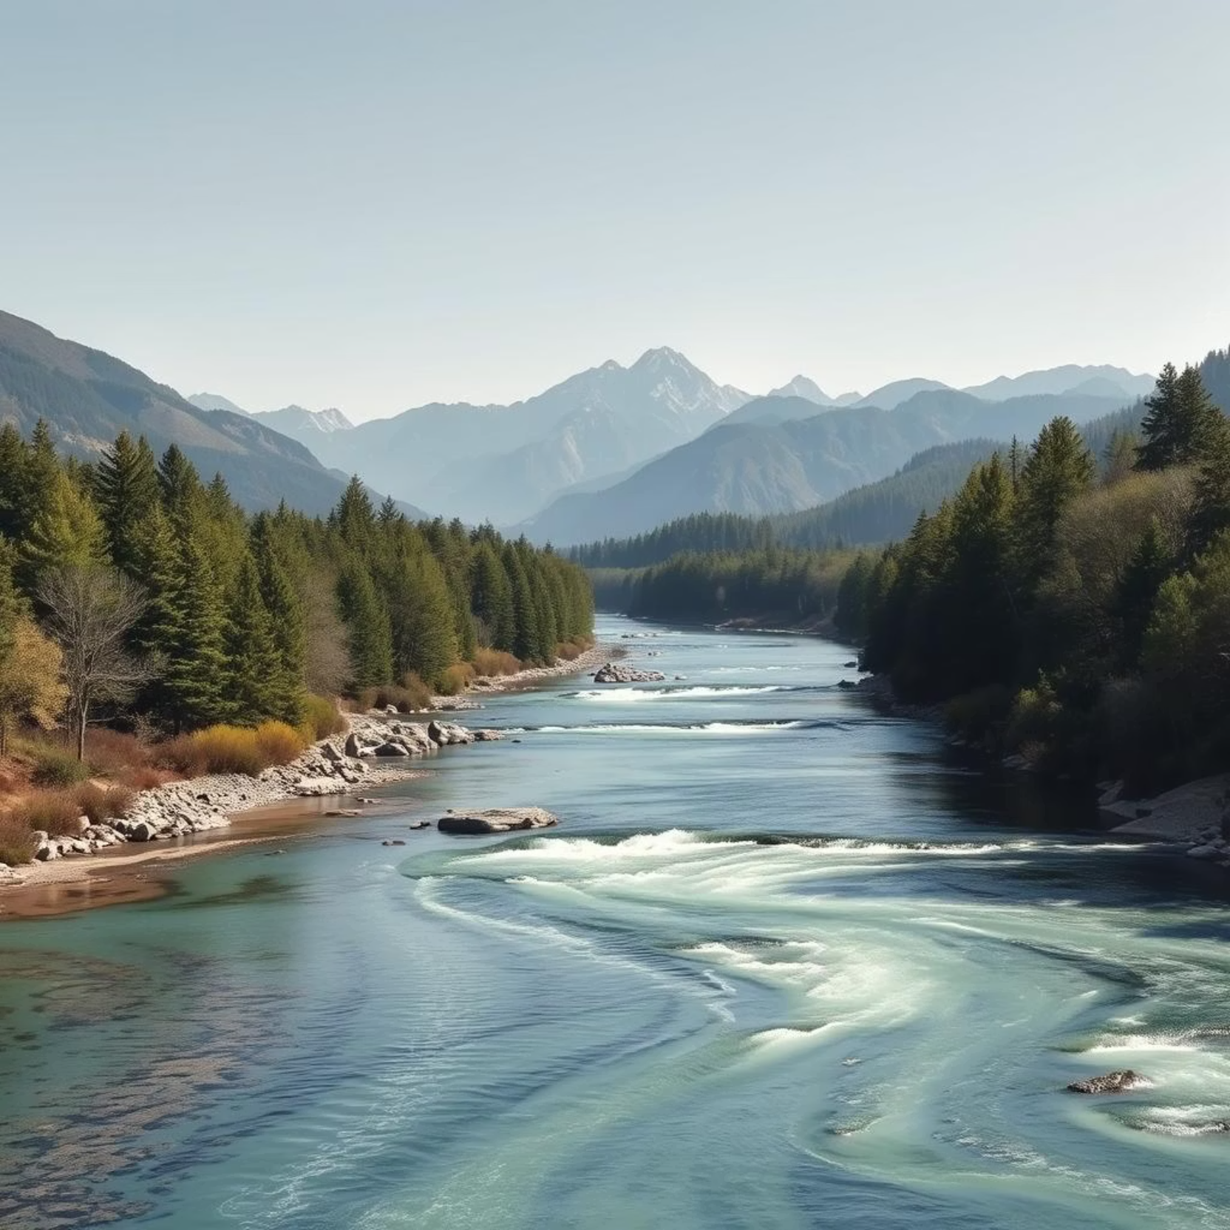
Sources of Water
Natural sources: rivers, lakes, groundwater
Contamination from organic and inorganic matter
Need for analysis and treatment

Slide 8



Water Characteristics
Physical Characteristics
Observable properties like temperature, color, taste, odor, and turbidity that influence water's aesthetic and functional quality.
Chemical Characteristics
Compositional aspects such as pH, presence of inorganic ions, hardness, alkalinity, and salinity, which determine water's reactivity and corrosivity.
Biological Characteristics
Presence and types of microorganisms (bacteria, viruses, algae) that affect water potability and can cause biofouling in industrial systems.

Slide 9
1. Physical Characteristics
Physical characteristics are primarily assessed through sensory observation and instrumental measurements, providing immediate indicators of water quality.
Temperature
Color
Influences water's density, viscosity, surface tension, conductivity, salinity, and the solubility of dissolved gases. Higher temperatures typically reduce gas solubility and increase reaction rates.
Indicates the presence of organic substances like algae, humic compounds, or industrial effluents. True color is measured after removing turbidity.
Taste & Odor
Turbidity
Often due to dissolved gases (e.g., hydrogen sulfide), organic compounds, or microbial activity. Odor intensity is a quantitative measure of this characteristic.
A measure of water's light-transmitting properties, caused by suspended and colloidal materials like clay, silt, organic matter, and microorganisms. High turbidity can hinder disinfection.

Slide 10





2. Chemical Characteristics
Chemical characteristics of water define its reactivity and suitability for various uses, influencing corrosion, scaling, and overall system performance.
pH
Inorganic Ions
Hardness
A measure of acidity or alkalinity. Affects chemical reactions, corrosion rates, and the effectiveness of disinfectants.
Includes minerals like Ca, Mg, Na, K, Cl⁻, SO₄²⁻, and NO₃⁻. Their concentrations dictate water's hardness, salinity, and potential for scaling or corrosive behavior.
Caused by dissolved calcium and magnesium ions. Leads to scale formation in pipes and boilers, reduces soap efficiency, and can impact industrial processes.
Alkalinity
Salinity
Water's capacity to neutralize acids, largely due to bicarbonates, carbonates, and hydroxides. Acts as a buffer against pH changes.
The total concentration of all dissolved salts. High salinity makes water unsuitable for many industrial and agricultural uses.

Slide 11
3. Biological Characteristics
Water quality is significantly impacted by the presence of various microorganisms. These biological characteristics are critical for assessing water safety and purity.
Bacteria
Protozoa
Viruses
Microscopic single-celled organisms, some of which are pathogenic and can cause diseases like cholera or E. coli infections.
Larger single-celled organisms, such as Giardia and Cryptosporidium, known for causing gastrointestinal illnesses.
Submicroscopic infectious agents that can cause diseases like hepatitis A or norovirus, often difficult to remove by conventional filtration.
Worms
Fungi
Larger parasitic organisms, including helminths, whose eggs or larvae can be transmitted through contaminated water.
Although less commonly pathogenic through water, some fungal spores can indicate contamination or affect water aesthetics.

Slide 12
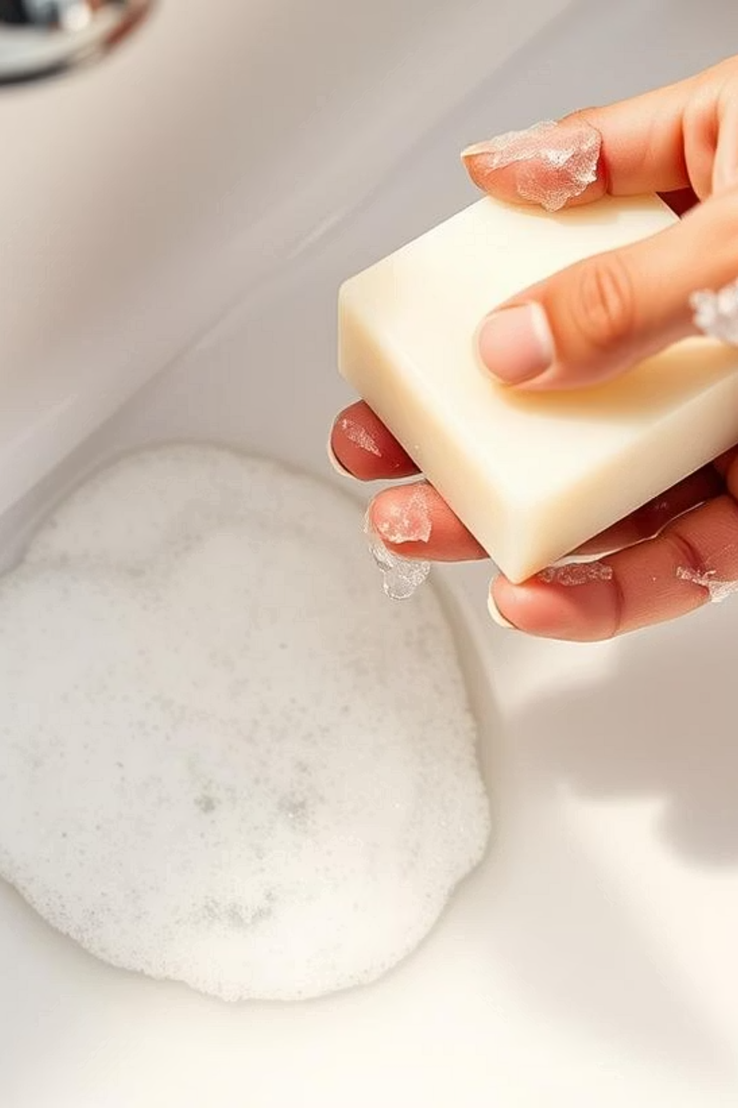
Hardness of Water: An Overview
Water hardness is a measure of the concentration of dissolved minerals, primarily calcium (Ca²⁺) and magnesium (Mg²⁺) ions.
Definition: Water that does not produce lather with soap is termed as hard water.
Causes: Presence of multivalent metallic cations, predominantly Ca²⁺ and Mg²⁺ ions.
Effects: Significantly affects soap efficiency, leading to increased soap consumption. It also causes the formation of scale deposits in pipes and appliances, reducing their lifespan and efficiency.
Chemical Reaction: When hard water reacts with soap (sodium salt of stearic or palmitic acid), it forms an insoluble curdy precipitate.
2C₁₇H₃₅COONa + CaCl₂ → Ca(C₁₇H₃₅COO)₂↓ + 2NaCl
2C₁₇H₃₅COONa + MgSO₄ → (C₁₇H₃₅COO)₂Mg↓ + Na₂SO₄

Slide 13
Types of Hardness
Hardness of Water
Temporary Hardness (Carbonate)
Permanent Hardness (Non-Carbonate)

Slide 14
Temporary Hardness
Due to bicarbonates of calcium and magnesium
Removed by boiling or lime treatment
Bicarbonate is converted into carbonate (insoluble precipitate)
Ca(HCO₃)₂ → CaCO₃↓ + H₂O + CO₂↑
Mg(HCO₃)₂ → Mg(OH)₂↓ + 2CO₂↑
By adding hydrated lime to precipitate insoluble carbonate.
Ca(HCO₃)₂ + Ca(OH)₂ → 2CaCO₃↓ + 2H₂O
Mg(HCO₃)₂ + Ca(OH)₂ → Mg(OH)₂↓ + 2CaCO₃↓ + 2H₂O
1. By Boiling
2. By Adding Hydrated Lime (Clark's Process)

Slide 15
Permanent Hardness
Permanent hardness is more challenging to remove than temporary hardness, requiring specialized water softening techniques.
Caused by soluble chlorides, sulfates, and nitrates of calcium and magnesium.
It cannot be removed by boiling or simple lime treatment.
Removal: Eliminated by advanced water softening techniques such as:
Lime-soda process
Zeolite process
Ion-exchange resin method
Reverse osmosis

Slide 16
The Imperative of Measuring Water Hardness
Accurately measuring water hardness is critical for various applications, ensuring water quality and preventing industrial and domestic issues.
Measurement Methods
Boiler Feed Water Quality Control
3
Drinking Water Safety Standards
1
2
Soap Titration
EDTA Method
Scale and Sludge Formation
Reduced Heat Transfer Efficiency
Corrosion and Pipe Damage
Monitoring hardness ensures compliance with aesthetic and operational guidelines for potable water.

Slide 17
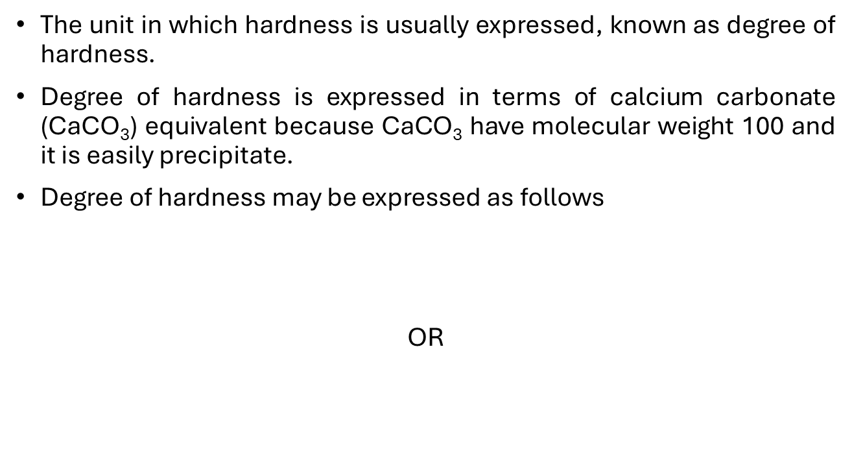
Degree of Hardness
The unit in which hardness is usually expressed, known as degree of hardness.
Degree of hardness is expressed in terms of calcium carbonate (CaCO₃) equivalent because CaCO₃ have molecular weight 100 and it is easily precipitate.
Degree of hardness may be expressed as follows
OR

Slide 18
Degree of Hardness
Measure of Hardness | Hardness (mg/l as CaCO₃)
Soft | 0 – 100
Moderate | 100 – 200
Hard | 200 – 300
Very hard | 300 – 500
Extremely hard | 500 – 1,000

Slide 19




Units of Water Hardness
Water hardness is expressed in various units globally, with each unit representing the equivalent concentration of calcium carbonate (CaCO₃).
Parts per Million (ppm)
Milligram per Litre (mg/L)
The number of equivalent parts of CaCO₃ present per million (10⁶) parts of water by weight.
The number of milligrams of CaCO₃ present in one liter of water. Numerically, 1 mg/L is equivalent to 1 ppm.
Degree Clarke (°Cl)
Degree French (°Fr)
Commonly used in the UK, it represents the number of equivalent parts of CaCO₃ present per 70,000 parts of water.
Predominant in France, it signifies the number of equivalent parts of CaCO₃ present per 10⁵ parts of water.
Correlation: 1 ppm = 1 mg/L = 0.07 °Cl = 0.1 °Fr

Slide 20
Assignment: Problems based on Hardness of Water
Problem 1: If a sample of water contains 50 mgs of Ca²⁺ ions per litre, calculate its hardness in terms of CaCO₃ equivalent?
Problem 2: A Water sample contains 204 mg of CaSO₄ and 73 mg of Mg(HCO₃)₂ per litre. What is the total hardness in terms of CaCO₃ equivalent? (Mol mass of CaSO₄ = 136, Mg(HCO₃)₂ = 146)
Problem 3: Calculate the carbonate and non-carbonate hardness of a sample of water containing the dissolved salts as given below in mgs/lit . Mg(HCO₃)₂ = 7.3; Ca(HCO₃)₂ = 40.5; CaSO₄ = 13.6; MgCl₂ = 21.75. (Mol mass of CaSO₄ = 136, Mg(HCO₃)₂ = 146, Ca(HCO₃)₂ = 162, MgCl₂= 95)
Problem 4: A sample of water is found and contain the following analytical data in mgs/lit. Mg(HCO₃)₃ = 14.6; MgCl₂ = 9.5; MgSO₄ = 6.0; Ca(HCO₃)₂ = 16.2. Calculate the temporary and Permanent hardness of the sample of water?(Mol Mass of MgSO₄ =120)

Slide 21
Questions
1. Which of the following is a physical characteristic of water? A. pH B. Hardness C. Turbidity D. Alkalinity
2. The chemical property that indicates water's acidity or alkalinity is: A. TDS B. DO C. pH D. BOD
3. Which parameter is used to measure organic pollution in water? A. Turbidity B. pH C. BOD D. Hardness
4. Which of the following is a biological characteristic of water? A. Sulfate content B. Color C. Bacteria presence D. Conductivity
5. Dissolved oxygen (DO) in water is important because it: A. Increases turbidity B. Promotes corrosion C. Supports aquatic life D. Increases hardness

Slide 22
Questions
1. Hardness of water is mainly due to: A. Sodium and potassium ions B. Calcium and magnesium ions C. Iron and aluminium ions D. Chloride and nitrate ions
2. Temporary hardness is caused by: A. Chlorides and sulfates B. Nitrates and phosphates C. Bicarbonates of Ca and Mg D. Carbonates and hydroxides
3. Which of the following methods removes permanent hardness? A. Boiling B. Filtration C. Lime-soda process D. Aeration
4. Hardness is usually expressed in terms of: A. NaCl B. CaCO₃ equivalent C. MgCl₂ equivalent D. SO₄²⁻ content
5. What is one negative effect of hard water in households? A. Increases water flow B. Enhances soap lathering C. Reduces heating efficiency due to scale formation D. Increases pH of water

Slide 23
Take away of the session
Definition: Hardness is caused by the presence of dissolved calcium (Ca²⁺) and magnesium (Mg²⁺) ions.
Types:
Temporary Hardness: Due to bicarbonates of Ca and Mg; removed by boiling.
Permanent Hardness: Due to chlorides and sulfates; not removed by boiling.
Units: Expressed in mg/L or ppm as CaCO₃ equivalent.
Effects: Causes scaling in boilers, soap wastage, and reduces detergent efficiency.
Removal Methods:
Temporary: Boiling, lime treatment
Permanent: Zeolite, Ion exchange, Lime-soda process

Slide 24
Learning Outcomes
BTL1: Remember water types and hardness definitions
BTL4: Solve numerical problems based on hardness
CO1: Understand hardness determination methods
CO4: Solve water quality-related problems
Mapped Course Outcomes

Slide 25
References
Engineering Chemistry by Jain and Jain.

